Slide 1
Kaggle & Colab Guide for Final Project
2020 Spring

Slide 2
Kaggle Submission

Slide 3
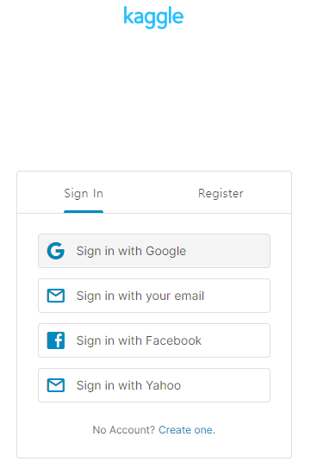
Join Kaggle competition
Go to www.kaggle.com and click the button ‘Sign In’ in the top right corner of the page.
Sign in with your account and set your id to ‘YOUR NAME’

Slide 4

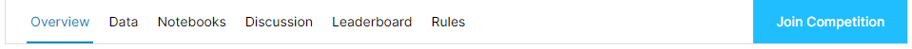
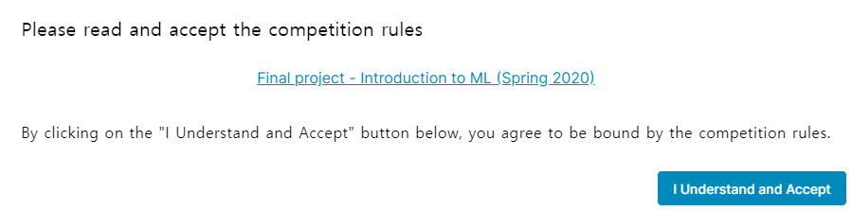
Join Kaggle competition
Go to Kaggle ‘competition’ page in the document ‘Final_project.pdf’.

Slide 5
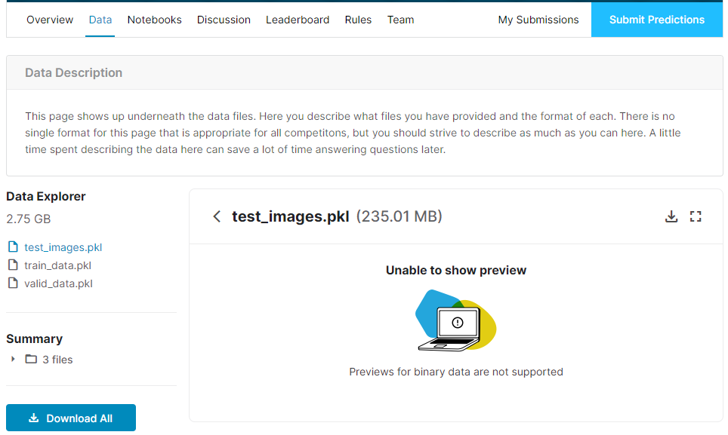
Download Dataset
Go to ‘Data’ tab and Click ‘Download All’ button for downloading dataset.

Slide 6
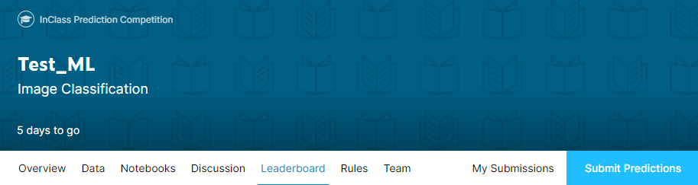
Submission in Kaggle
Click ‘Submit Predictions’ button for submission.

Slide 7
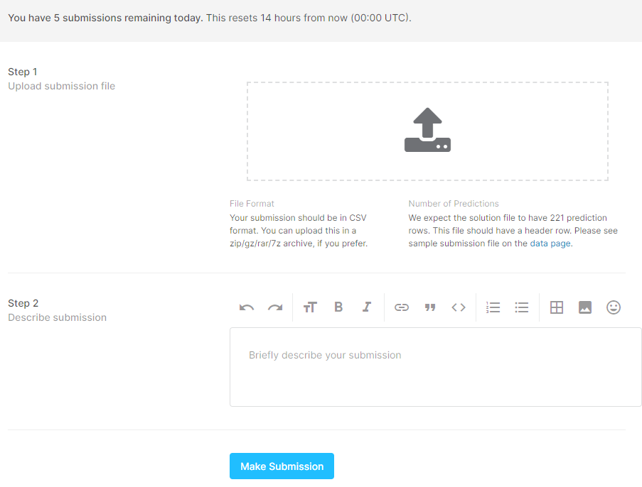
Submission in Kaggle
Upload the ‘submission.csv’ file and Click ‘Make Submission’ button.
The csv file name must be the same as ‘submission.csv’.

Slide 8
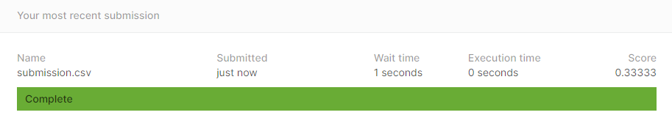
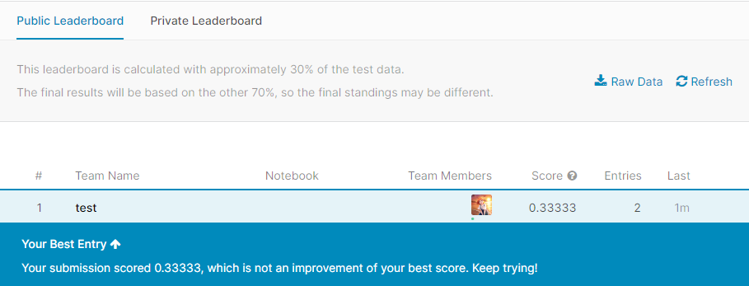
Submission in Kaggle
You can check whether your file is submitted correctly.
Submissions status and your standing in public leaderboard are shown as follows:

Slide 9
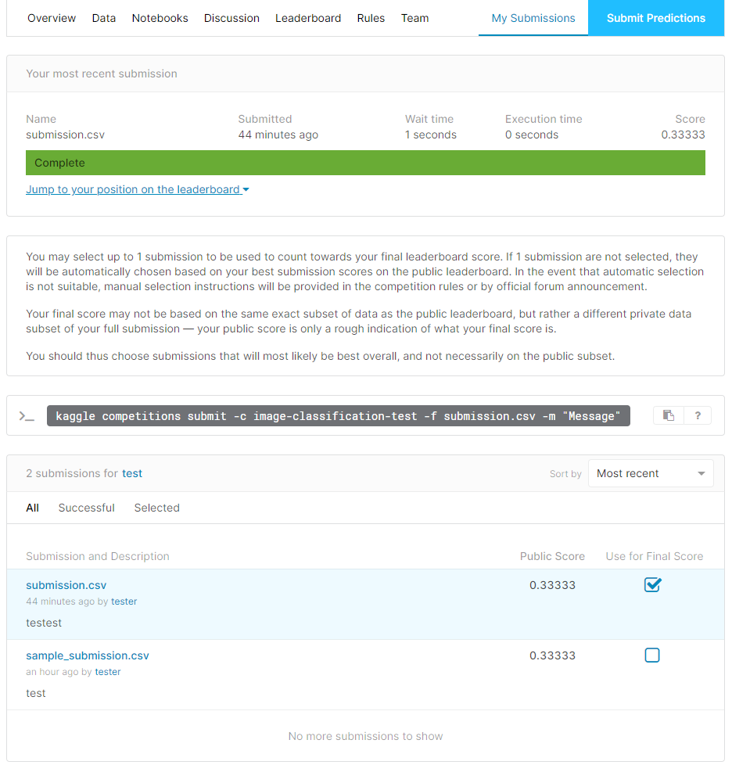
Submission in Kaggle
Click the button ‘My Submissions’, then you can select 1 submission for final standings.

Slide 10
Colab Guide

Slide 11
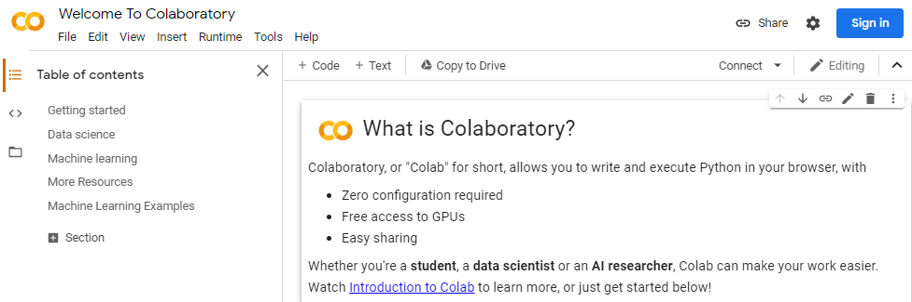
Getting started with Colab
Go to https://colab.research.google.com/notebooks/welcome.ipynb.
Click ‘Sign in’ button and login with your account.

Slide 12
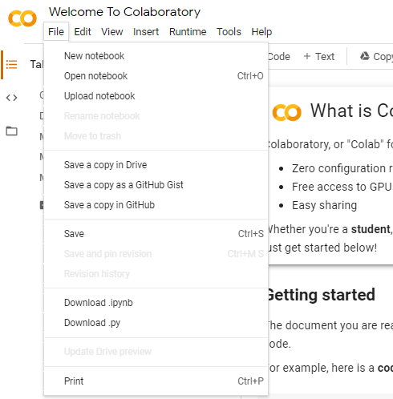
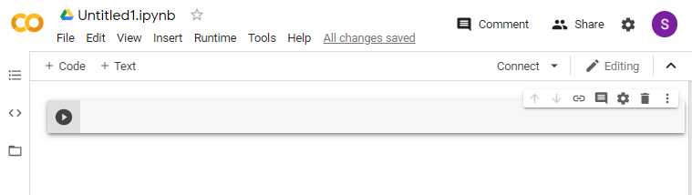
Getting started with Colab
Click File – New notebook, then you can get the new notebook.

Slide 13
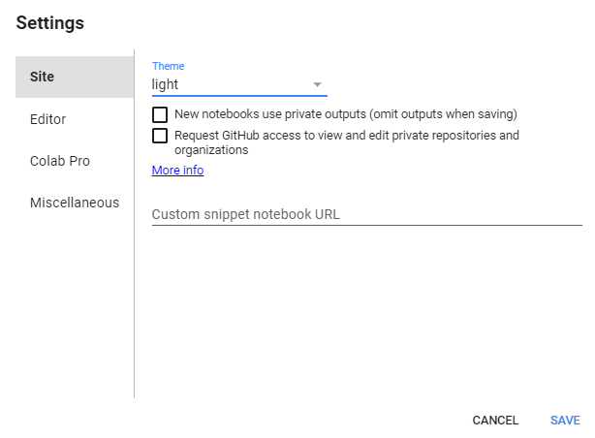
Getting started with Colab
Click the button, then you can set it to the setting you want.
E.g. Theme: light -> dark

Slide 14
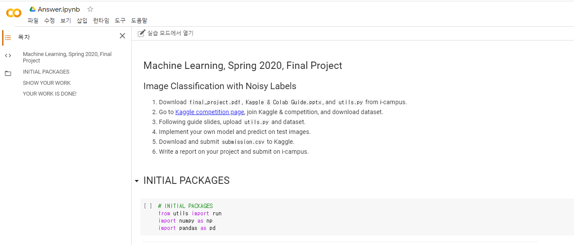
Starting Your Project – (1) ‘Answer.ipynb’
Open ‘Answer.ipynb’ with given link
Link

Slide 15
Starting Your Project – (1) ‘Answer.ipynb’
The first screen when you open the file is as follows. Click Open as Lab mode

Slide 16
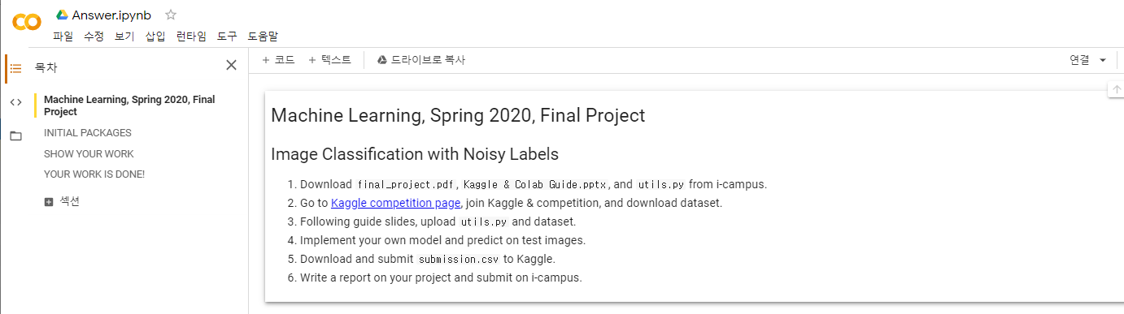
Starting Your Project – (1) ‘Answer.ipynb’
Copy file to your drive

Slide 17
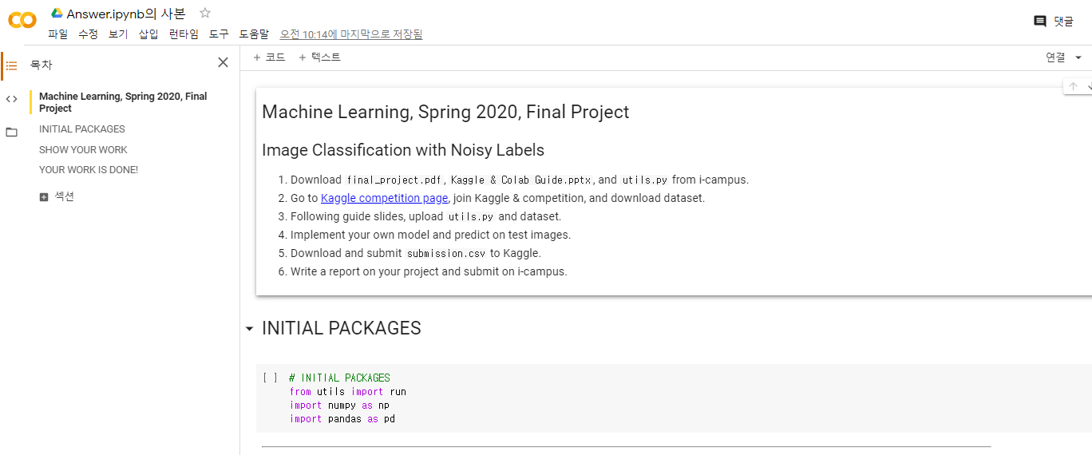
Starting Your Project – (1) ‘Answer.ipynb’
Now, you are ready to go.

Slide 18
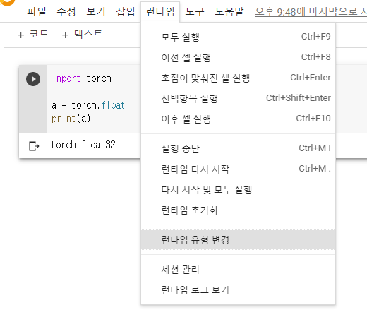
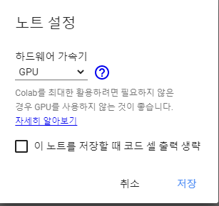
Starting Your Project – (2) Prepare GPU environment (Optional)
Change Runtime into GPU
[런타임] - [런타임 유형 변경]
[하드웨어 가속기] - GPU select
(If your code not use GPU, then select ‘없음’)

Slide 19
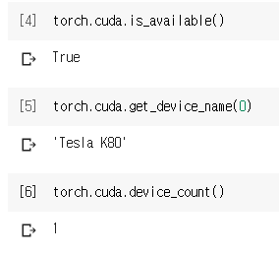
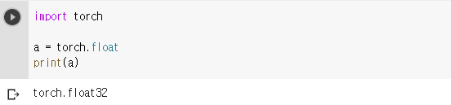
Starting Your Project – (2) Prepare GPU environment (Optional)
Check if your GPU runtime is ready

Slide 20
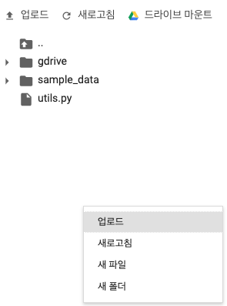
Starting Your Project – (3) Prepare Utils
Upload utils.py
The following files should exist.
(1) ./utils.py
(Ignore ‘sample_data’)
Mouse right click
If you quit colab, you will have to upload these files again.

Slide 21
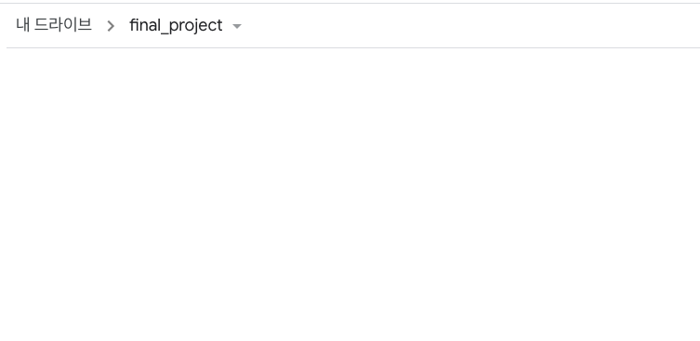
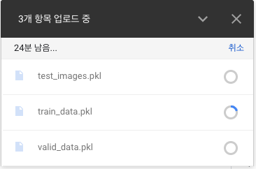
Starting Your Project – (4) Prepare Data
Since data is large, we cannot upload data directly to Colab.
We will connect Google Drive with Colab.
Make directory ‘final_project’ in your Google Drive and upload data.

Slide 22
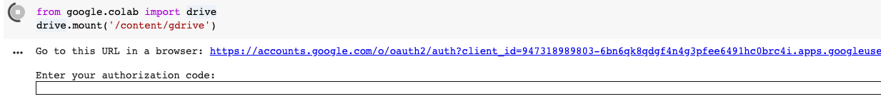
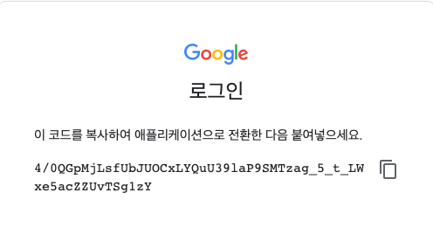
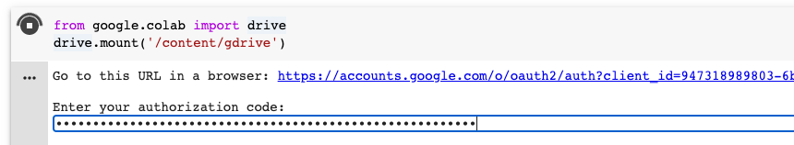
Starting Your Project – (4) Prepare Data
Mount Google Drive and check if data_path is correctly set

Slide 23
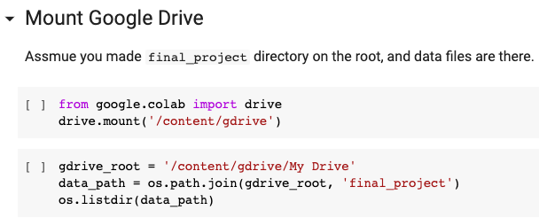
Starting Your Project – (4) Prepare Data
In your ‘Answer.ipynb’, set ‘data_path” as the directory you just made

Slide 24
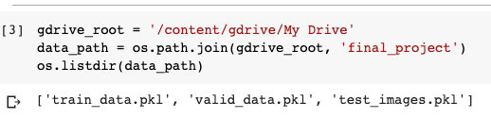
Starting Your Project – (4) Prepare Data
Check if data directory is correctly connected.

Slide 25
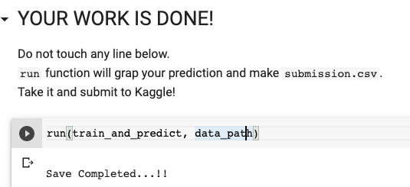
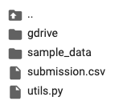
Submit your answer
'run’ function automatically make your submission
Download and submit to Kaggle

